Slide 1



AgriSure
Group 7.1
Ng I Wen 33213399
Benjamin Keah Czen Khun 33212600
Dylan S. Gill 29940400
Koo Hong Minn 33590028
Zoe Yow Cui Yi 33214476

Slide 2

Content
01
07
Key Resources
Introduction
02
08
Key Activities
Customer Segment
03
09
Key Partnerships
Value Proposition
04
10
Cost Structure
Channels
05
11
Conclusion
Customer Relationship
06
12
Q&A Session
Revenue Streams
Presented by Dylan Gill

Slide 3


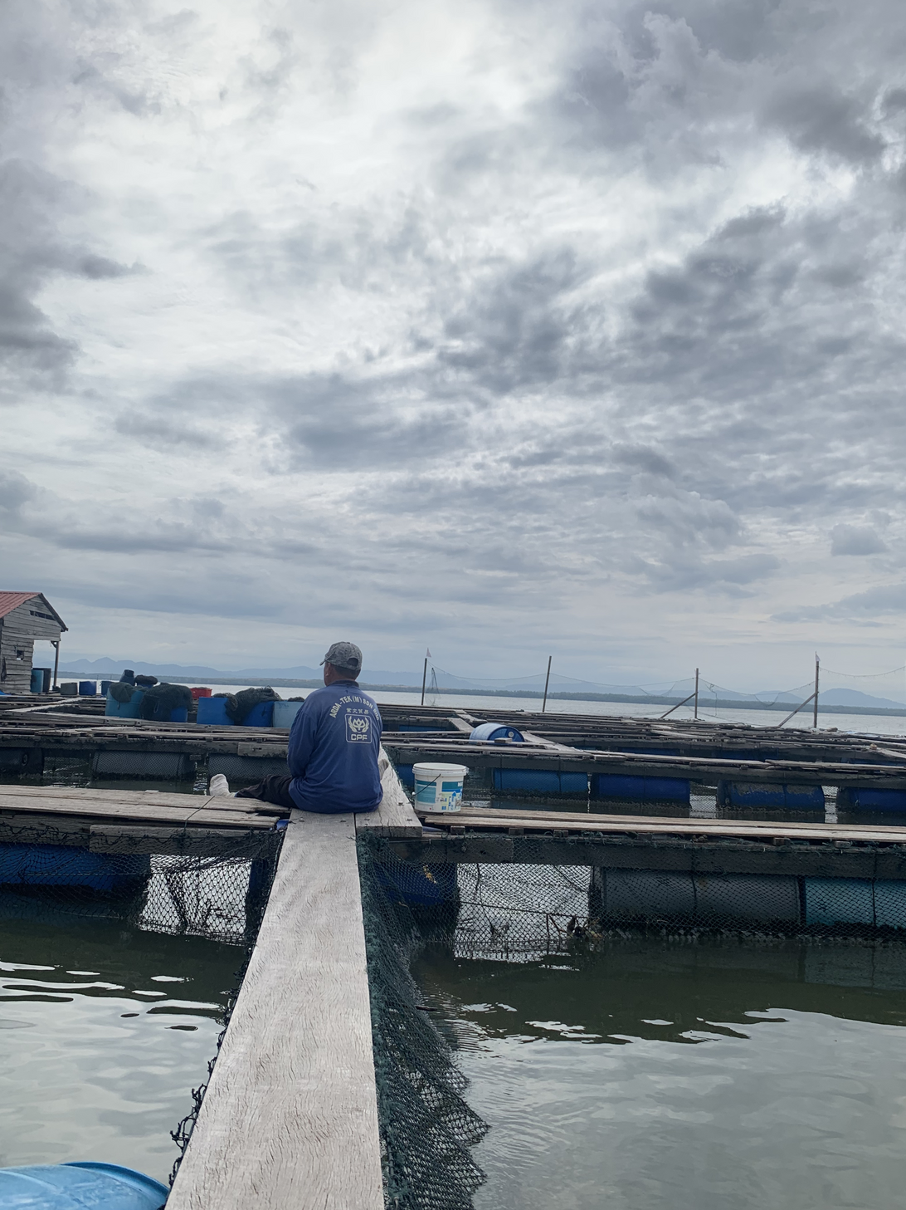
Customer Segment
Focuses on targeting people working in the agricultural sector, as it:
Provides physical security and protection over their crops, livestock, and the demand and supply of their goods.
Assists government agencies and NGOS on providing necessary services and security towards the industry.
Farmers
Livestock Farmers
Aquaculture and Fisheries
Presented by Dylan Gill

Slide 4
Value Proposition
Value
Needs
Affordable
Accessible
Assistance
Financial protection and stability
Accessibility
Affordability
Problem
Financial Instability
Presented by Benjamin Keah
Notes:
Value:
- affordable
- accessible
- assistance
Problems:
- financial instability
Needs:
- financial protection and stability
- accessibility
- affordability
Product and services for specific customer segments:
- small-scale farmers in Msia
> mobile micro insurance
> flexible PAYG financial services
> local agent support
- rural and remote farmers
> accessibility
> local agent support
- fishermen in aqua culture
> insurance
> expert consultation
- all farmers
> additional tools (weather forecast, market insights)
- government agencies and NGOs
> extend coverage, promote financial inclusion, increase financial literacy, and inclusion in rural populations

Slide 5
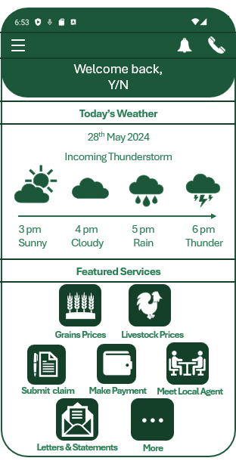
Value Proposition
Product and Services for Specific Segments
Small-scale farmers in Msia
Mobile micro insurance
Flexible PAYG financial services
Local agent support
Rural and remote farmers
Accessibility
Local agent support
Fishermen in aqua culture
Insurance
Expert consultation
All farmers
Additional tools (weather forecast, market insights)
Government agencies and NGOs
Extend coverage, promote financial inclusion → increase financial literacy, and inclusion in rural populations
Presented by Benjamin Keah
Notes:
Value:
- affordable
- accessible
- assistance
Problems:
- financial instability
Needs:
- financial protection and stability
- accessibility
- affordability
Product and services for specific customer segments:
- small-scale farmers in Msia
> mobile micro insurance
> flexible PAYG financial services
> local agent support
- rural and remote farmers
> accessibility
> local agent support
- fishermen in aqua culture
> insurance
> expert consultation
- all farmers
> additional tools (weather forecast, market insights)
- government agencies and NGOs
> extend coverage, promote financial inclusion, increase financial literacy, and inclusion in rural populations

Slide 6
Channels
Awareness
Phase
Evaluation
Phase
Purchase
Phase
Web sales
Social Media Campaigns
Advertisements
SEO targeting agriculture demographics
Comprehensive Coverage plans
Acts of god
Natural disasters
crop failure
Seamless payment options
PAYG financial services
Mobile micro insurance
Wholesaler
Partnership with supplier and buyer
Payment Flexibility
Built-in app functionality and Support Services
Sales force
door-to-door sales
word of mouth
Presented by Ng I Wen

Slide 7
Channels
Delivery
Phase
Post-sales
Phase
Customer Support and Engagement
Local agent assistance
Educational Support
Submitting claims through built in-app
Smart contract
Mobile online agent to support
Claims Processing
Efficient Claims Processing
On-the-Ground Support
Presented by Ng I Wen

Slide 8



Customer Relationships
Payment Solutions
Flexible Pay-As-You-Go Options: Payments via phones or monthly phone bills.
Integrated Payment Methods: Supports low-income farmers
Time Management Solutions
Automatic SMS Reminders: For payments and renewals.
Faster Claiming Process: Simplified mobile access to policy information.
Customer Support
24/7 Customer Care: Phone, SMS, and online chat.
Proactive Engagement: Immediate response to queries and issues.
Trust and Reliability
Open Communication: Ensures clients are informed of rights and benefits.
Local Agents: Enhance trust with personalized, relatable service.
Presented by Koo Hong Minn
Notes:
Payment Solutions:
Flexible Pay-As-You-Go Options: Payments via phones or monthly phone bills.
Integrated Payment Methods: Supports low-income farmers
Time Management Solutions:
Automatic SMS Reminders: For payments and renewals.
Faster Claiming Process: Simplified mobile access to policy information.
Trust and Reliability:
Open Communication: Ensures clients are informed of rights and benefits.
Local Agents: Enhance trust with personalized, relatable service.
Customer Support:
24/7 Customer Care: Phone, SMS, and online chat.
Proactive Engagement: Immediate response to queries and issues.

Slide 9
Revenue Streams
Primary Revenue Source
Diversified Plans: Offering various agriculture insurance plans (crop failure, natural disasters, etc.) to meet different customer needs.
Effective Pricing Strategies: Ensuring premiums are set at levels that cover risk and generate profit.
Premium payments: collecting regular premium payment for the coverage provided
Investment Income
Investing Premiums: Allocating collected premiums into stocks, bonds, real estate, and other assets.
Returns on Investment: Generating additional revenue from the returns on these investments.
Presented by Ng I Wen

Slide 10




Key Resources
Management Team
Field Agents
IT Team
Marketing and Sales Team
Actuaries and Underwriters
Legal and Compliance Team
04
01
Office Space
IT infrastructure
Field Equipment
Marketing Materials
Insurance Expertise
SEO Expertise
Market Research
Regulatory Knowledge
Technology Development
Partnerships
Payment Integration
Start-up Funding
Operational Budget
Claims Reserve
Technology Investment
Marketing Budget
03
02
Presented by Zoe Yow

Slide 11



Key Activities
01
02
03
Mobile Network Operators (MNOs) Partnerships
Community Networks and Local Partnerships
Marketing and Outreach
Financial Institutional Partnerships
Production
Problem Solving
Platform/Network
Product Development
Technology Infrastructure Development
Claims Processing
Educational Content Creation
Risk Assessment and Management
Customer Support
Trust Building and Community Engagement
Adapting to Local Conditions
Presented by Zoe Yow

Slide 12





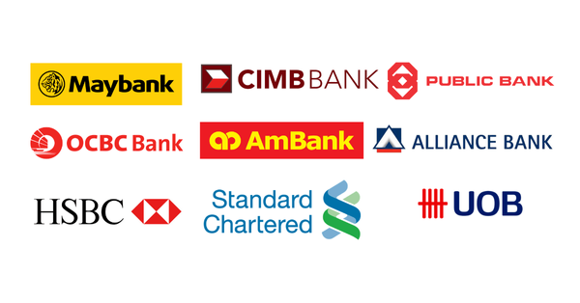





Key Partnerships
Key suppliers
GO and NGOS
Partners
Presented by Dylan Gill

Slide 13

Cost Structure
Expense Category | Annual Approximated Amount (RM)
Technology and Infrastructure | 130,000
Sales and Marketing | 55,000
Partnership and Comission | 150,000
Customer Suuport and Service | 120,000
Claims and Payouts | 500,000
Regulatory and Compliance | 80,000
Research and Development | 150,000
Employee Wages | 250,000
TOTAL | 1,435,000
Presented by Koo Hong Minn

Slide 14
Statement of Profit and Loss for Year 1 Operation
Revenues | RM
Premium subscriptions | 750,000
Interest from reserve funds | 15,000
Partnership and Collaborations | 125,000
Insurance float investments | 37,500
TOTAL REVENUE | 927,500
Expenses | RM
Technology and Infrastructure | 130,000
Sales and Marketing | 55,000
Partnership and Commission | 150,000
Presented by Koo Hong Minn

Slide 15
Statement of Profit and Loss for Year 1 Operation
Expenses | RM
Customer Support and Service | 120,000
Reserve Funds for Claims and Payouts | 300,000
Regulatory and Compliance | 80,000
Research and Development | 150,000
Employee Wages | 250,000
TOTAL EXPENSES | 1,235,000
NET PROFIT (LOSS) | -307,500
Presented by Koo Hong Minn

Slide 16
Statement of Profit and Loss for Year 2 Operation
Revenues | RM
Premium subscriptions | 1,250,000
Interest from reserve funds | 30,000
Partnership and Collaborations | 245,000
Insurance float investments | 62,500
TOTAL REVENUE | 1,587,500
Expenses | RM
Technology and Infrastructure | 100,000
Sales and Marketing | 35,000
Presented by Koo Hong Minn

Slide 17
Statement of Profit and Loss for Year 2 Operation
Expenses | RM
Partnership and Commission | 165,000
Customer Support and Service | 120,000
Regulatory and Compliance | 55,000
Research and Development | 150,000
Employee Wages | 320,000
TOTAL EXPENSES | 1,445,000
NET PROFIT | 142,500
Presented by Koo Hong Minn

Slide 18
Thank you!

